Slide 1
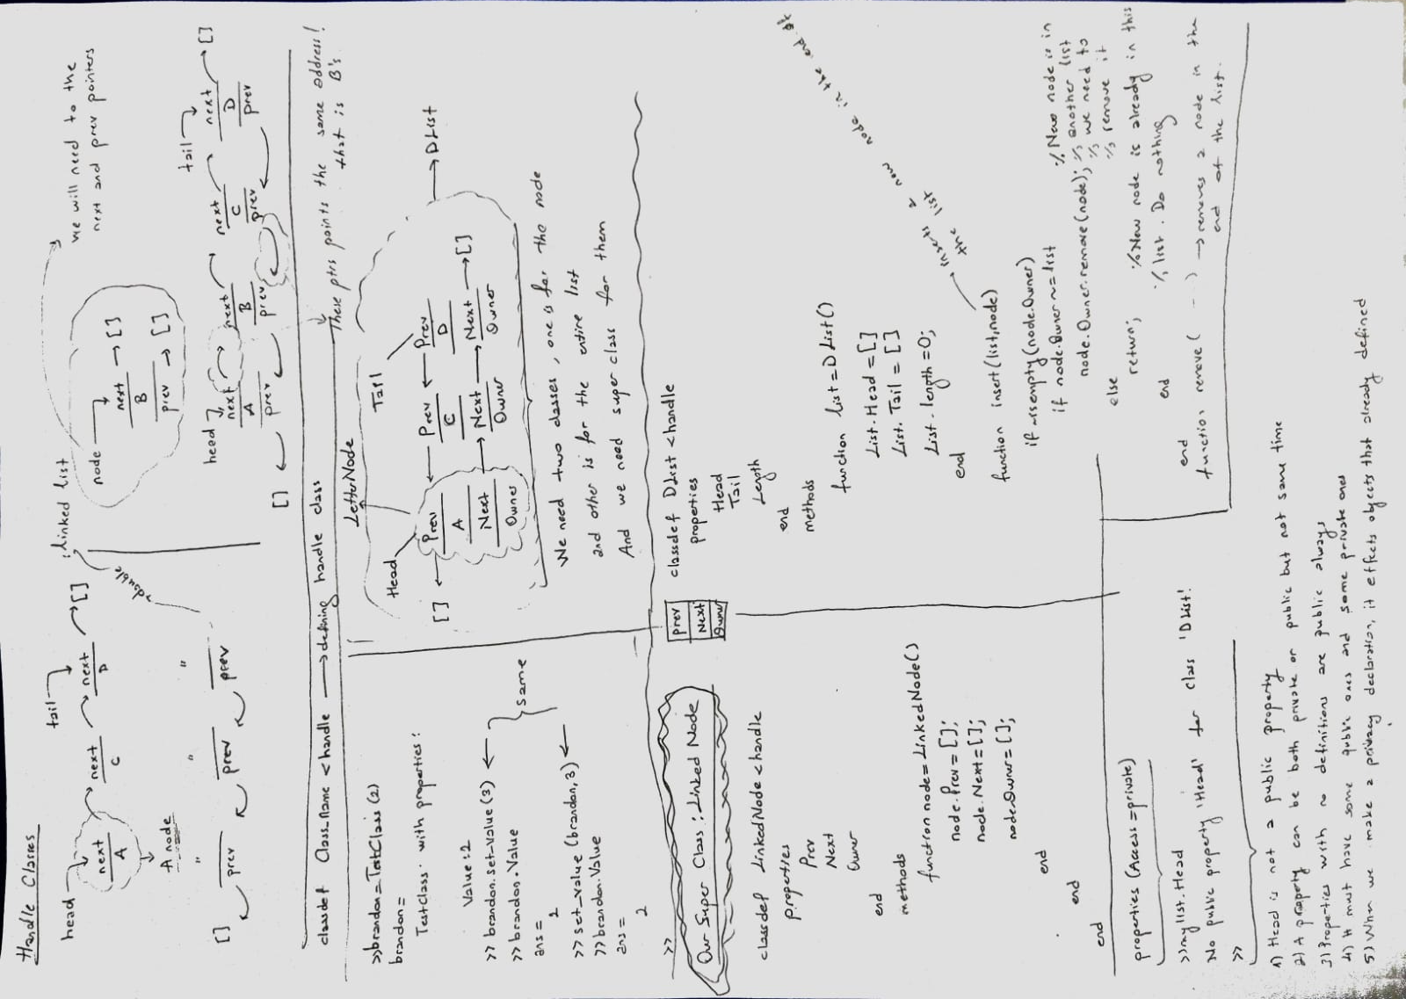

Slide 2
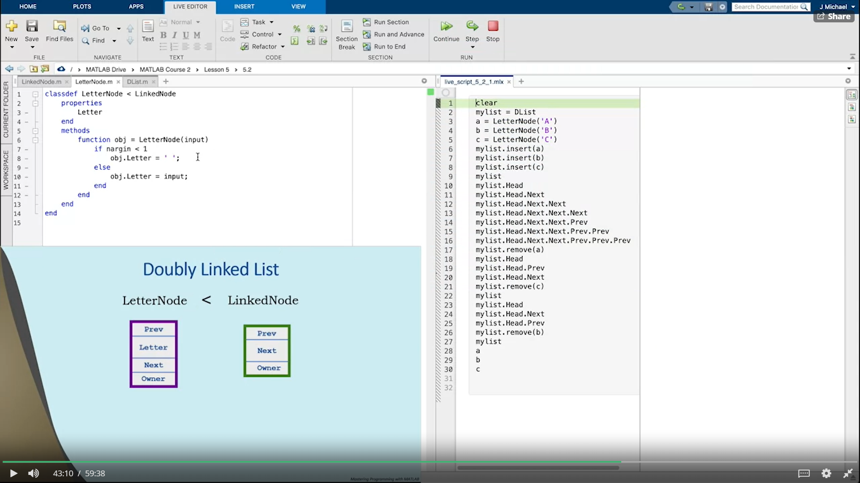

Slide 3
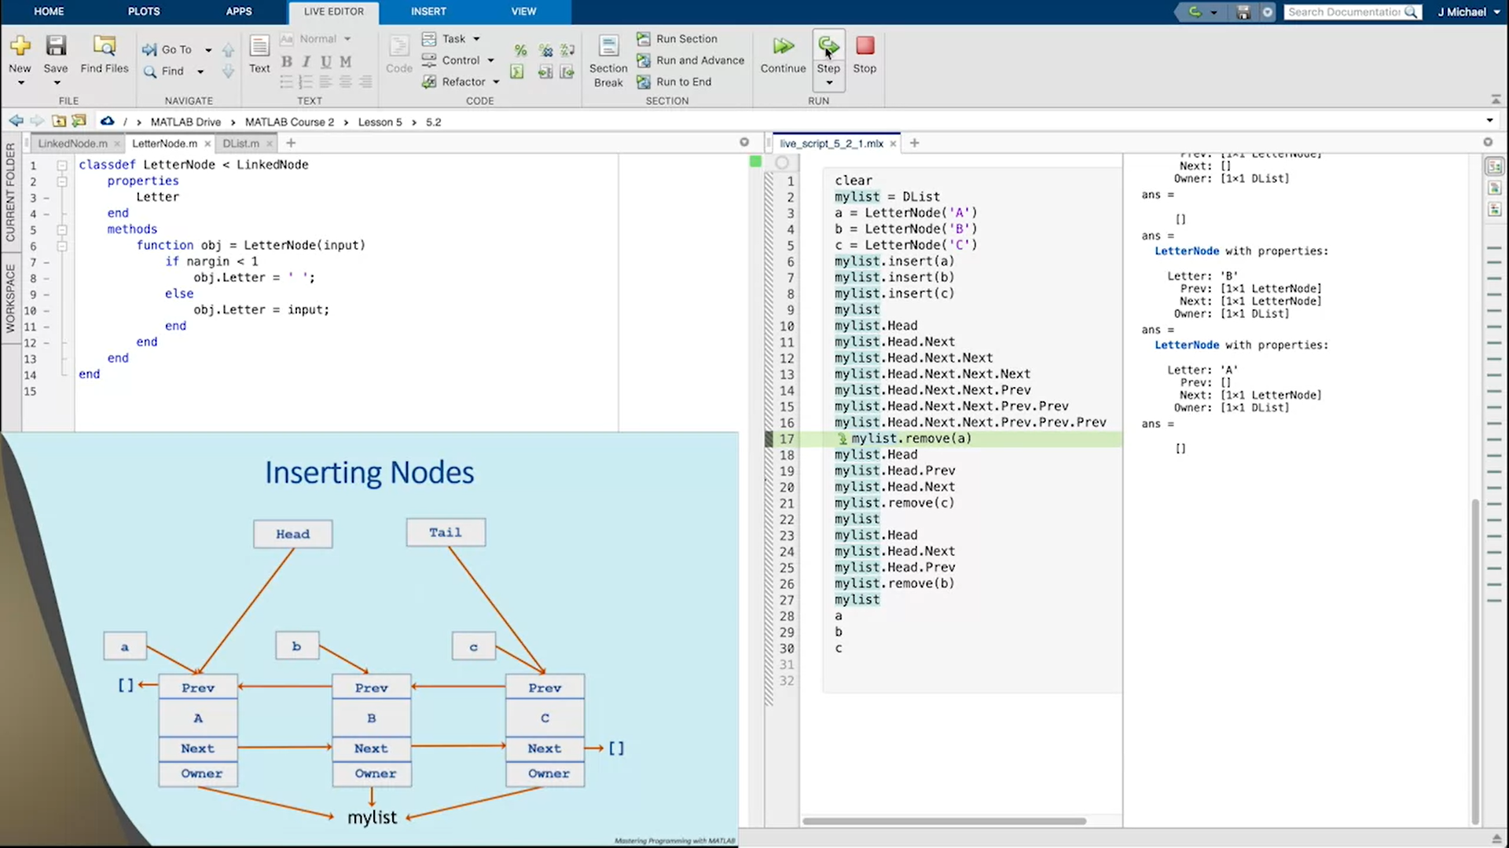

Slide 4
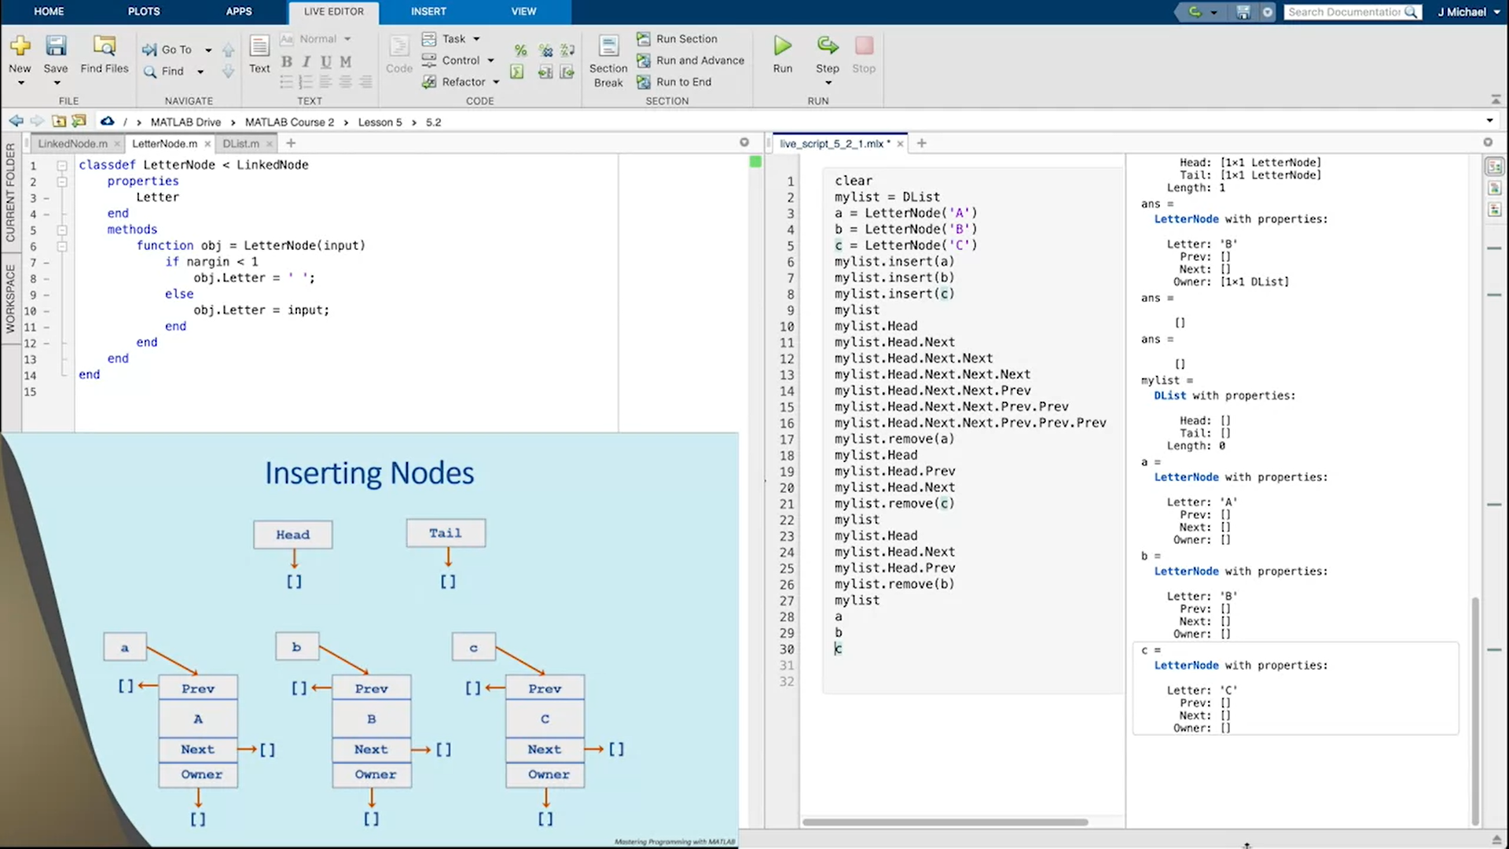

Slide 5
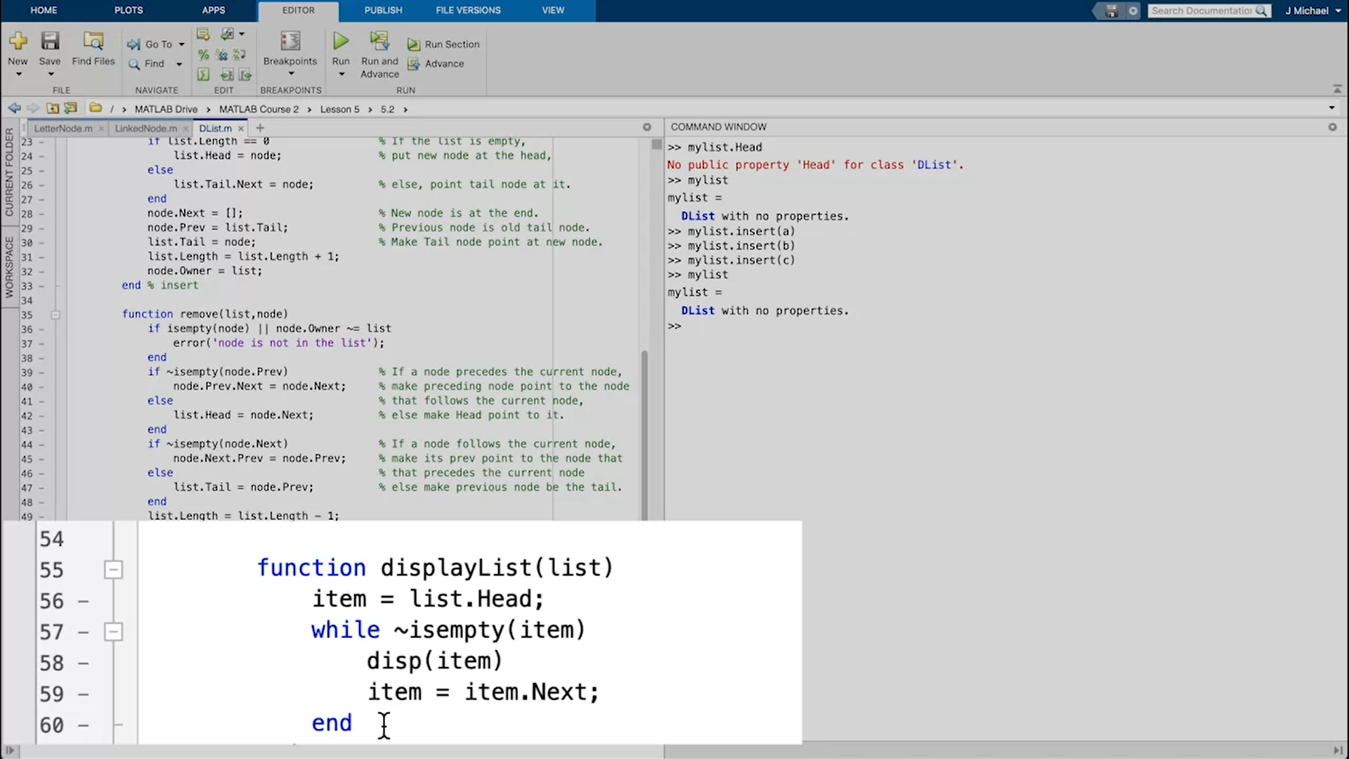

Slide 6
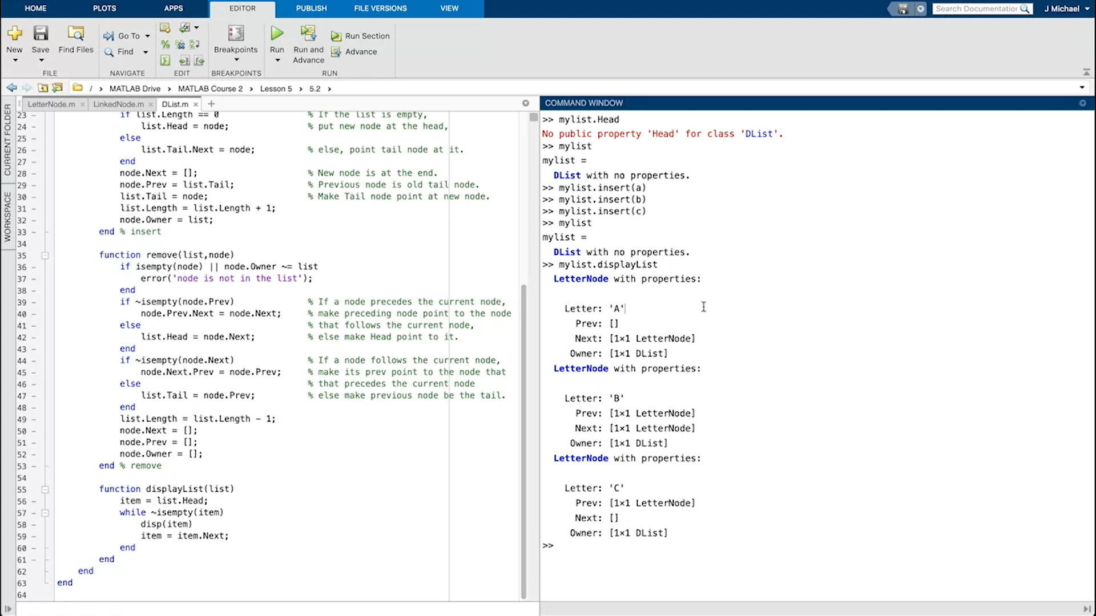

Slide 7
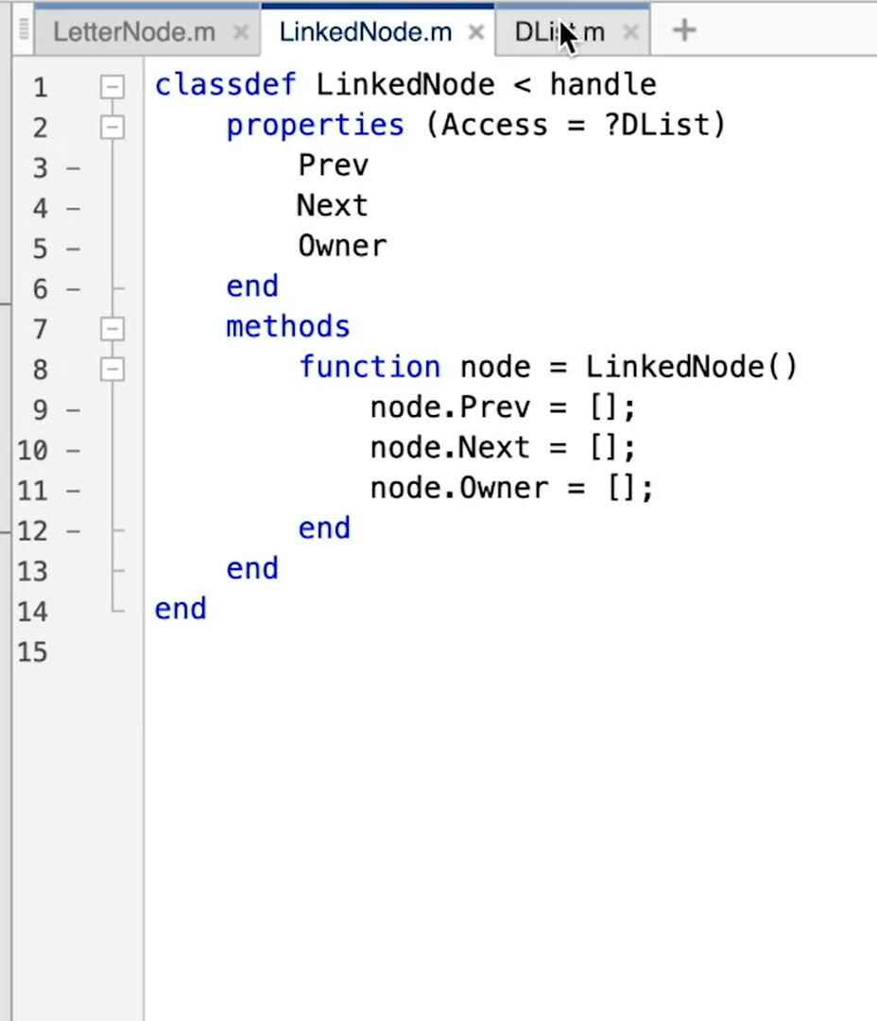
Access=?DList means only DList can access to the properties of LinkedNode
When we type mylist.displayList in the command window , it throws an error and the solution is that Access=?DList

Slide 8
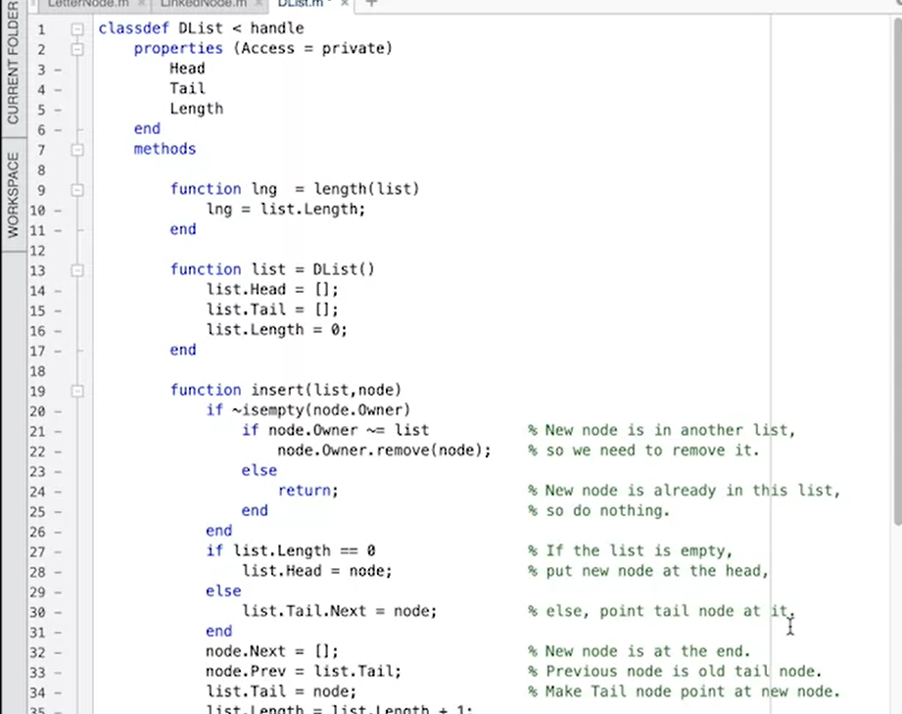
We added length() function because users might want the length of the list. And we cannot use get.length() method cause our length property is private.. Thus, we use regular function such as length().
>>mylist.length
>>length(mylist)

